Slide 1
Course by Course Equivalency
Presented By – Hrishikesh Gadkari
November 13, 2018
Notes:
Light weight version of how to transfer credits to Old Dominion University

Slide 2

Why the refresh?
Monarch Transfermation : A previous version of the project although not quiet advantageous
Outdated GUI
Too many unnecessary questions
A lot of typing
No Filter option
Redo all the steps for another course
Difficult to navigate
Not quite comprehensive
Notes:
A good GUI will help in easier interaction with the system. Also too many questions which involves a lot of typing like whats ur intended major, intended role or degree and many more. Won’t it be easier if we had to just enter the name of the school from where we are transferring the credits. And get the results right away Moreover no filter action for which we have to redo all the steps for adding or updating another course

Slide 3

Refreshed Website
Better looking GUI
Non Complex Interface
Pretty Straightforward Interface
No Redundant Input Fields
Faster results
Contended results page
Easy to add and delete courses and schools
User can filter the results as per the needs
Option to print and email marked courses for later date
Notes:
Add Favorites

Slide 4
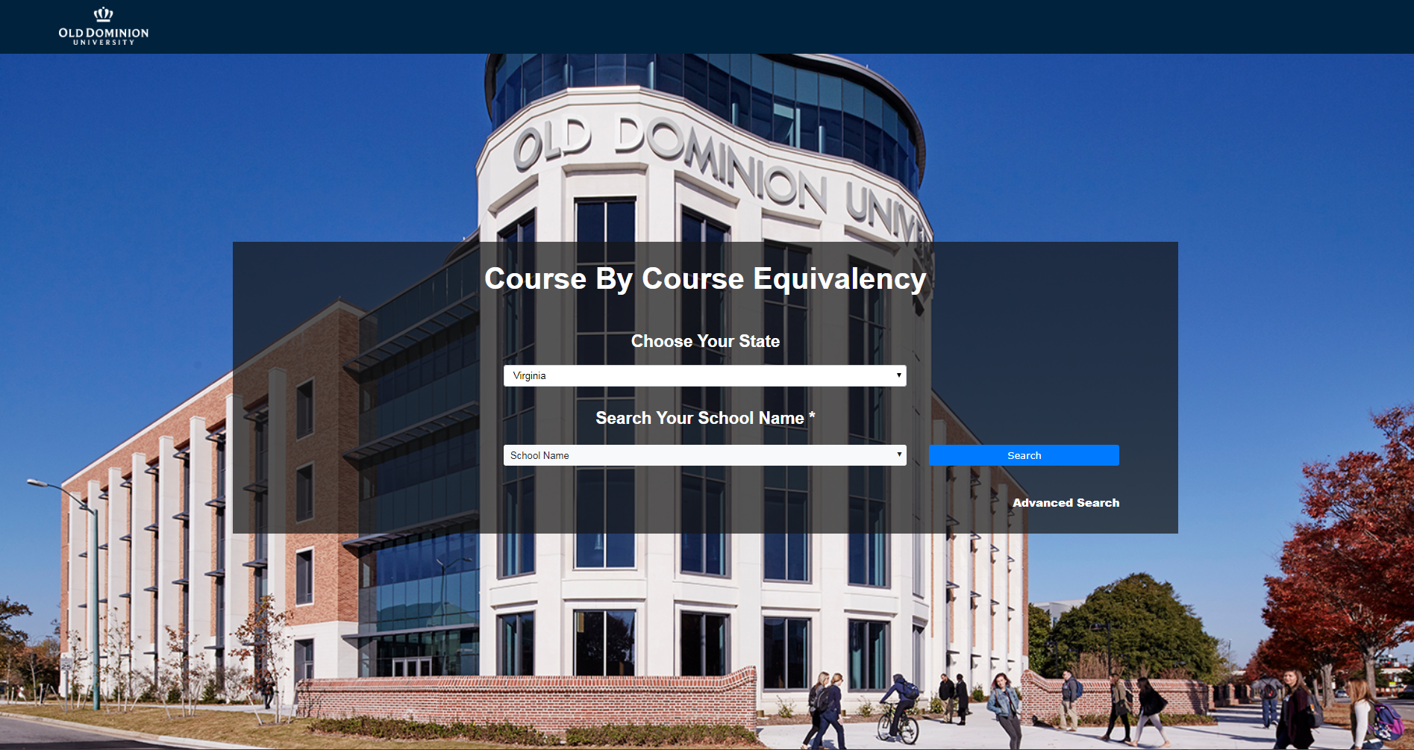
Course By Course Equivalency

Slide 5
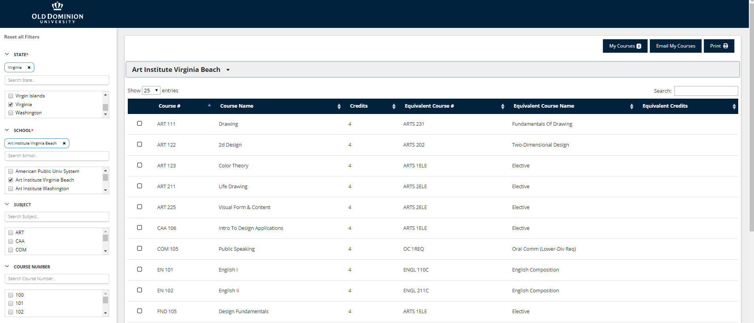

Slide 6
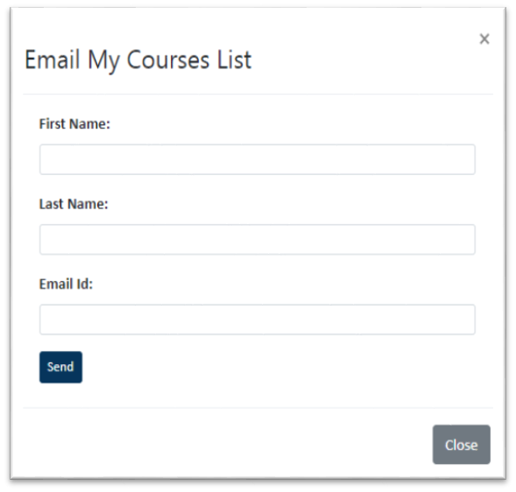
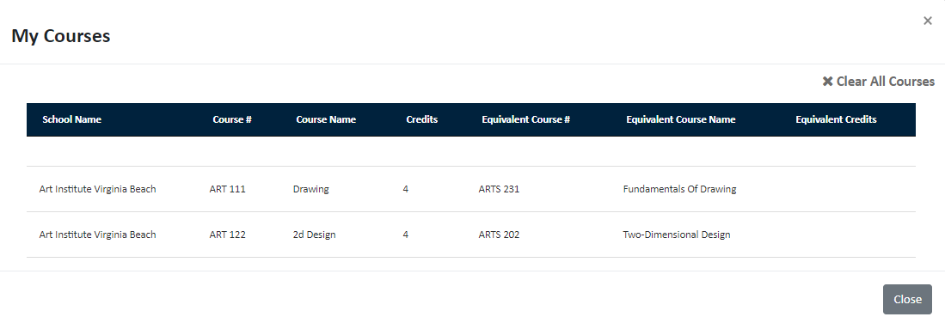

Slide 7

Skills learned
PHP
SQL
JQuery
JavaScript
JSON
Notes:
Configuring SQL server , Connectng PHP with SQL, Some of the Jquery and JavaScript libraries, Querying JSON data for faster results. As this is a Production ready website which is used by the university for students gives me confidence of developing websites for companies as well.

Slide 8
Future Work
Make it easier to build a cart to add all credits from multiple institutions
Find the program the user is interested in during lead capture

Slide 9
Any Questions?

